Slide 1

Transform Data with
Notes:
After collecting and loading data, almost all datasets need to be cleaned in some way. The dplyr package provides functions to carve, expand, and collapse a data frame that will cover 95% of use cases.

Slide 2

Exercise 1
Open 03-Transform.Rmd Run the setup chunk
01:00

Slide 3
Orders data set
Outpatient lab test orders
45,000 rows x 17 columns
library(tidyverse)
library(readxl)
orders <- read_excel("data/orders_data_set.xlsx")
Notes:
The data set for this lesson is derived from orders for clinical laboratory tests in an electronic health record system in a set of outpatient clinics. The orders were deidentified and time-shifted (and approved for use as a teaching resource).
One could have many different goals for analyzing this data . One may be interested in:
Volumes off tests, and where they are being ordered from
How ordersets are driving test utilization
The turnaround time between different phases of testing
Trends in cancelation and their causes
The tools I am about to present to you are agnostic to these and can be used to address the vast majority of types of questions one could ask abuot standard data sets derived from electronic health data.

Slide 4
Variable | Description
order_id | Key for order
patient_id | Key for patient
description | Text description of lab test
proc_code | Procedure code for lab test
order_class_c_descr | Setting test is intended to be performed in (eg. Normal = regular blood draw)
lab_status_c | Code for status of laboratory result
lab_status_c_descr | Status of laboratory result
order_status_c | Code for status of order
order_status_c_descr | Status of order
reason_for_canc_c | Code for cancellation reason (if applicable)
reason_for_canc_c_descr | Cancellation reason (if applicable)
order_time | Timestamp for time of original test order
result_time | Timestamp for most recent result in the record
review_time | Timestamp for provider acknowledgment of review of result
department | Clinic associated with test order
ordering_route | Structure/menu in health record from which order was placed
pref_list_type | Category of preference list (if applicable)
Notes:
Because some of you may not be familiar with this type of data, we include a small data dictionary below to explain some of the data.
There are some column pairs with very similar names: one variable is a code ("_c") and the other is a description ("_c_descr"). This is largely done for convenience in querying the data or subsetting it without typing long strings.

Slide 5
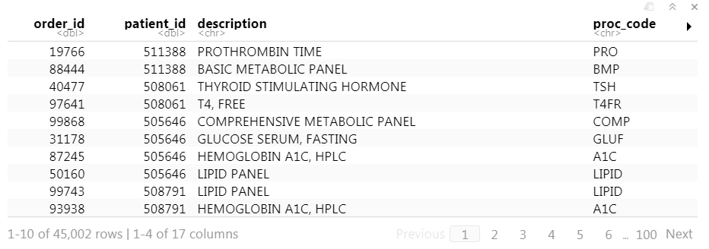
orders
Notes:
To get a very quick and high-level understanding of the dataset simply type the name of the variable containing the dataset and execute it. Rstudio will provide an interactive representation of the data as a quick glance into what is contained in the variable.
In our case, execute the code chunk containing the word ‘orders.’ You will see a short summary of the data appear below the code chunk.

Slide 6
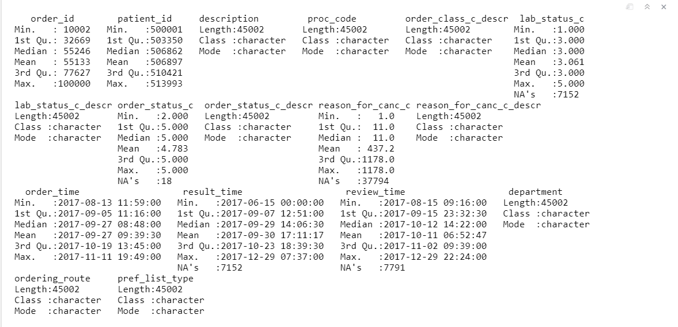
summary(orders)
Notes:
Alternatively, one could use the ‘summary()’ function on the ‘orders’ data frame. This will provide a more comprehensive and statistical picture of the data in each column of the data frame.

Slide 7

The Data Analysis Process

Slide 8
The Data Analysis Process
Visualize
Import
Tidy
Model
Communicate
Transform

Slide 9
“Happy families are all alike; every unhappy family is unhappy in its own way.”
–– Leo Tolstoy
“Tidy datasets are all alike, but every messy dataset is messy in its own way.”
–– Hadley Wickham

Slide 10
dplyr
dplyr implements a grammar for transforming tabular data.
Notes:
Getting your data into this format requires some upfront work, but that work pays off in the long term. Once you have tidy data and the tidy tools provided by packages in the tidyverse, you will spend much less time munging data from one representation to another, allowing you to spend more time on the analytic questions at hand. The dplyr package provides functions that begin this process, they help you carve, expand, and collapse data.

Slide 11
common syntax
Each function takes a data frame as its first argument and returns a data frame as its output.
filter(data, ...)
dplyr function
data frame to transform
specific arguments

Slide 12
Isolating data
Extract variables with select()
Extract rows with filter()
Arrange rows, with arrange().
Notes:
We will start with three functions that are handy ways to find the data you’re interested in the large laboratory datasets regularly dumped on you. Reducing a data set to a subset of columns and/or rows are common operations, particularly on the path to answering a specific set of questions about a data set.

Slide 13

select()
Notes:
We will start slowly, with the select function.It’s not uncommon to get datasets with hundreds or even thousands of variables. In this case, the first challenge is often narrowing in on the variables you’re actually interested in. select() allows you to rapidly zoom in on a useful subset using operations based on the names of the variables.

Slide 14
select()
Extract columns from a data frame
select(data,... )
data frame to transform
name(s) of columns to extract
(or a select helper) function)
data frame to transform
Notes:
The first dplyr function we’ll look at is select(). Select extracts columns from a data frame.
Select takes a data frame as its first argument.
After that it takes any number of additional arguments that specify the columns that you want to pick. In it’s simplest form, those additional arguments will just be the names of the columns that you want to select. However, in very wide datasets, writing out the names of the columns you want can sometimes be laborious. It doesn’t scale well. That’s why the developers of the dplyr function have added several convenience functions that can more succinctly identify the columns you want. We’ll cover that after the next exercise.

Slide 15
select()
Extract columns by name.
select(data,... )
select(orders, description, department)
data frame to transform
name(s) of columns to extract
(or a select helper) function)
data frame to transform
Notes:
Let’s take a look at the orders data frame that we loaded earlier in the lesson, for example.
The select statement will take the data frame ‘orders’, and return a new data frame that only has the columns description and department. You could list as many or as few column names as you want in the select function, it will bring back everything you list.

Slide 16
select()
Extract columns by name.
select(orders, description, department)
orders
description | department
PROTHROMBIN TIME | INTERNAL MEDICINE CLINIC
BASIC METABOLIC PANEL | INTERNAL MEDICINE CLINIC
THYROID STIMULATING HORMONE | ENDOCRINOLOGY CLINIC
T4, FREE | ENDOCRINOLOGY CLINIC
order_id | patient_id | description | proc_code | department
19766 | 511388 | PROTHROMBIN TIME | PRO | INTERNAL MEDICINE CLINIC
88444 | 511388 | BASIC METABOLIC PANEL | BMP | INTERNAL MEDICINE CLINIC
40477 | 508061 | THYROID STIMULATING HORMONE | TSH | ENDOCRINOLOGY CLINIC
97641 | 508061 | T4, FREE | T4FR | ENDOCRINOLOGY CLINIC
description | department
PROTHROMBIN TIME | INTERNAL MEDICINE CLINIC
BASIC METABOLIC PANEL | INTERNAL MEDICINE CLINIC
THYROID STIMULATING HORMONE | ENDOCRINOLOGY CLINIC
T4, FREE | ENDOCRINOLOGY CLINIC
Notes:
So, if you were to use the code above, the orders data frame would be accepted as input and a subset of it, the Description and the Department columns would be returned as output

Slide 17
select()
Extract columns by index.
select(orders, c(1,4))
orders
description | department
PROTHROMBIN TIME | INTERNAL MEDICINE CLINIC
BASIC METABOLIC PANEL | INTERNAL MEDICINE CLINIC
THYROID STIMULATING HORMONE | ENDOCRINOLOGY CLINIC
T4, FREE | ENDOCRINOLOGY CLINIC
order_id | patient_id | description | proc_code | department
19766 | 511388 | PROTHROMBIN TIME | PRO | INTERNAL MEDICINE CLINIC
88444 | 511388 | BASIC METABOLIC PANEL | BMP | INTERNAL MEDICINE CLINIC
40477 | 508061 | THYROID STIMULATING HORMONE | TSH | ENDOCRINOLOGY CLINIC
97641 | 508061 | T4, FREE | T4FR | ENDOCRINOLOGY CLINIC
order_id | proc_code
19766 | PRO
88444 | BMP
40477 | TSH
97641 | T4FR
Notes:
Select is very flexible in terms of the ways that you can specify the columns you do or don’t want in the output. Here I’m showing you that I can give a numeric index of the columns that I want, in this cases the first and the fourth, and select dutifully provides these in the output. Note that when listing out these indexes one should put them in the ‘c’ (which stands for concatenate) function.

Slide 18
Exercise 2
Alter the code to select just the order_status_c column using the (1) column name and the (2) column number:
select(orders,description, department)
02:00

Slide 19
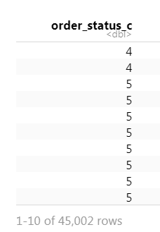
select(orders, order_status_c)
select(orders, 8)

Slide 20
select() helpers
: Select range of columns
select(orders, order_id:lab_status_c)
– Select every column but
select(orders, -c(description, order_status_c))
starts_with() Select columns that start with…
select(orders, starts_with("order"))
ends_with() Select columns that end with…
select(orders, ends_with(“descr"))
Notes:
Select provides many convenient ways to specify which columns you want. For instance, you can put the name of two columns separated by a colon mark, and select will return those two columns and all those in between. With select you could put a negative sign in front of a column name or a vector of column names and you'll get back everything except those columns. Then there's other functions that you can use inside of select that provide even more flexibility around defining which columns you want. For instance, you can use special function like starts_with and ends_with to instruct select on which columns you want based on a string.

Slide 21
select() helpers
contains() Select columns whose names contain…
select(orders, contains("time"))
matches() Select columns whose names match regular expression
select(orders, matches("^.{4}$"))
num_range() Select columns named in prefix, number style
select(orders, num_range("x“,1:5))
: Select range of columns
Notes:
Listed here are additional select helper functions. You can see they allow you to pull out columns whose names have a certain string in them or that match a certain regular expression. If you have a very large data set with many columns selecting variables out of it might be an important task and these functions might make it easier for you to identify desired columns in a more automated fashion.

Slide 22
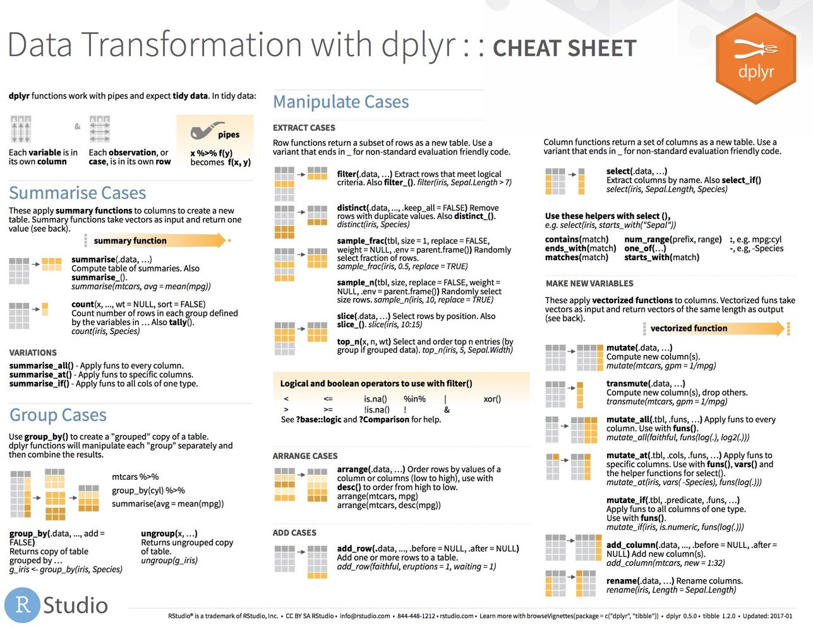
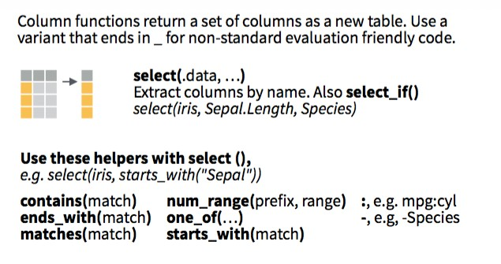

select() helpers
Notes:
I’ve only listed for you a selection of the available ways you can use helpers with select() to pull out the columns you need for your analysis. For a more complete list, see the select() section on the dplyr cheatsheet,

Slide 23
Consider #1
Which of these is NOT a way to remove the columns that represent status codes
(i.e. codes for lab status, order status, and cancelation)?
select(orders, -ends_with("_c"))
select(orders, -c(lab_status_c, order_status_c, reason_for_canc_c))
select(orders, -c(6,8,10))
select(orders, -contains("status"))
01:00
Notes:
Hint: Review the columns in the dataset by clicking on the arrow next to the orders data set in the environment tab in the upper right pane of Rstudio

Slide 24
Consider #1
Which of these is NOT a way to remove the columns that represent status codes
(i.e. codes for lab status, order status, and cancelation)?
select(orders, -ends_with("_c"))
select(orders, -c(lab_status_c, order_status_c, reason_for_canc_c))
select(orders, -c(6,8,10))
select(orders, -contains("status"))

Slide 25
select() – Also Helpful for renaming
select(orders,
desc = description,
dept = department)
description | department
PROTHROMBIN TIME | INTERNAL MEDICINE CLINIC
BASIC METABOLIC PANEL | INTERNAL MEDICINE CLINIC
THYROID STIMULATING HORMONE | ENDOCRINOLOGY CLINIC
T4, FREE | ENDOCRINOLOGY CLINIC
orders
order_id | patient_id | description | proc_code | department
19766 | 511388 | PROTHROMBIN TIME | PRO | INTERNAL MEDICINE CLINIC
88444 | 511388 | BASIC METABOLIC PANEL | BMP | INTERNAL MEDICINE CLINIC
40477 | 508061 | THYROID STIMULATING HORMONE | TSH | ENDOCRINOLOGY CLINIC
97641 | 508061 | T4, FREE | T4FR | ENDOCRINOLOGY CLINIC
desc | dept
PROTHROMBIN TIME | INTERNAL MEDICINE CLINIC
BASIC METABOLIC PANEL | INTERNAL MEDICINE CLINIC
THYROID STIMULATING HORMONE | ENDOCRINOLOGY CLINIC
T4, FREE | ENDOCRINOLOGY CLINIC
Notes:
select() is also handy when it comes to changing the names of your columns. Column names are inevitably terrible when you first receive your data as its often coming from a database or instrument. select() provides a quick way to do the renaming at the same time that you’re identifying your columns of interest.

Slide 26
rename()
rename(orders,
desc = description,
dept = department)
orders
order_id | patient_id | description | proc_code | department
19766 | 511388 | PROTHROMBIN TIME | PRO | INTERNAL MEDICINE CLINIC
88444 | 511388 | BASIC METABOLIC PANEL | BMP | INTERNAL MEDICINE CLINIC
40477 | 508061 | THYROID STIMULATING HORMONE | TSH | ENDOCRINOLOGY CLINIC
97641 | 508061 | T4, FREE | T4FR | ENDOCRINOLOGY CLINIC
description | department
PROTHROMBIN TIME | INTERNAL MEDICINE CLINIC
BASIC METABOLIC PANEL | INTERNAL MEDICINE CLINIC
THYROID STIMULATING HORMONE | ENDOCRINOLOGY CLINIC
T4, FREE | ENDOCRINOLOGY CLINIC
order_id | patient_id | desc | proc_code | dept
19766 | 511388 | PROTHROMBIN TIME | PRO | INTERNAL MEDICINE CLINIC
88444 | 511388 | BASIC METABOLIC PANEL | BMP | INTERNAL MEDICINE CLINIC
40477 | 508061 | THYROID STIMULATING HORMONE | TSH | ENDOCRINOLOGY CLINIC
97641 | 508061 | T4, FREE | T4FR | ENDOCRINOLOGY CLINIC
Notes:
R has many ways to rename columns because of how important it is. You can also use a dedicated dplyr function, rename() to accomplish this as well. Note that as opposed to select(), when using rename(), all the columns are retaimed in the output of the function.

Slide 27
filter()
Notes:
Now let's carve the data set in the other direction. If you need only a subset of rows from your data set, `filter()` allows you to pick rows (cases) based on values, ie. you can subset your data based on logic.

Slide 28
filter()
Extract rows that meet logical criteria.
filter(data,... )
one or more logical tests (filter returns each row for which the test is TRUE)
data frame to transform
Notes:
The syntax for filter is very similar to what we used for select. The first argument is a data frame from which we will be selecting rows. Afterwards we can input one more logical tests. R then performs that logical test on each row of the dataset and returns all rows in which the logical test was TRUE. Rows for which the tests are TRUE are returned in the output.

Slide 29
filter()
Extract rows that meet logical criteria.
filter(orders, patient_id==508061)
order_id | patient_id | description | proc_code
19766 | 511388 | PROTHROMBIN TIME | PRO
88444 | 511388 | BASIC METABOLIC PANEL | BMP
40477 | 508061 | THYROID STIMULATING HORMONE | TSH
97641 | 508061 | T4, FREE | T4FR
order_id | patient_id | description | proc_code
40477 | 508061 | THYROID STIMULATING HORMONE | TSH
97641 | 508061 | T4, FREE | T4FR
data frame to transform
Notes:
The syntax for filter is very similar to what we used for select. The first argument is a data frame from which we will be selecting rows. Afterwards we can input one more logical tests. R then performs that logical test on each row of the dataset and returns all rows in which the logical test was TRUE. Rows for which the tests are TRUE are returned in the output.

Slide 30
filter()
Extract rows that meet logical criteria.
filter(orders, patient_id==508061)
order_id | patient_id | description | proc_code
19766 | 511388 | PROTHROMBIN TIME | PRO
88444 | 511388 | BASIC METABOLIC PANEL | BMP
40477 | 508061 | THYROID STIMULATING HORMONE | TSH
97641 | 508061 | T4, FREE | T4FR
= sets
(returns nothing)
== tests if equal
(returns TRUE or FALSE)
data frame to transform
Notes:
Note that I used double equals inside of the filter function. Double equals means: compare the left hand side to the right hand side and if it’s the same, then return TRUE. The double equals is called the comparison operator. In contrast, a single equals sign sets a value to another. It is a very common mistake to accidentally use a single equals inside of the filter function, which will result in an error.

Slide 31
filter()
Extract rows that meet logical criteria.
filter(orders, proc_code=="BMP")
order_id | patient_id | description | proc_code
19766 | 511388 | PROTHROMBIN TIME | PRO
88444 | 511388 | BASIC METABOLIC PANEL | BMP
40477 | 508061 | THYROID STIMULATING HORMONE | TSH
97641 | 508061 | T4, FREE | T4FR
order_id | patient_id | description | proc_code
88444 | 511388 | BASIC METABOLIC PANEL | BMP
55526 | 511303 | BASIC METABOLIC PANEL | BMP
69809 | 509686 | BASIC METABOLIC PANEL | BMP
24316 | 503847 | BASIC METABOLIC PANEL | BMP
= sets
(returns nothing)
== tests if equal
(returns TRUE or FALSE)
Notes:
Similarly we can ask filter to return just the rows that represent a specific test being ordered, like a BMP. Note that when asking filter to return rows with specific text inside of it, we have to put that text in quotes.

Slide 32
Logical tests
x < y | Less than
x > y | Greater than
x == y | Equal to
x <= y | Less than or equal to
x >= y | Greater than or equal to
x != y | Not equal to
x %in% y | Group membership
is.na(x) | Is NA
!is.na(x) | Is not NA
Notes:
Here are some important logical operators to know about. They will all come in handy when you’re filtering rows of a data frame.
We’ve already seen the double equals. Note the less than or and greater than operators. These operators also come as “or equal to” versions.
Use != if you want to select rows in which a value is not equal to something else.
is.na is how you can test for missing values. This can be very useful as often times you want to remove missing values.
Note that in these examples x always represents the name of a column in your data frame.

Slide 33
Exercise 3
Use filter() with the logical operators to find:
Every order_id that is greater than 100000
All of the orders where lab_status_c_descr is equal to “Final result”
All of the orders where reason_for_canc_c_descr is not NA
04:00

Slide 34
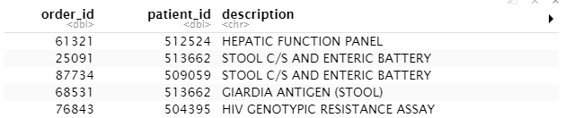
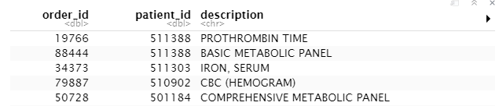
filter(orders, order_id > 100000)
filter(orders, lab_status_c_descr > "Final result")
filter(orders, !is.na(reason_for_canc_c_descr))

Slide 35
Common mistakes
1. Using = instead of ==
filter(orders, proc_code = “BMP")
filter(orders, proc_code == “BMP")
2. Forgetting quotes
filter(orders, Proc Code == COMP)
filter(orders, Proc Code == "COMP")

Slide 36
filter()
Extract rows that meet multiple logical criteria.
filter(orders, patient_id == 508061, description=="T4, FREE")
orders
order_id | patient_id | description | proc_code
19766 | 511388 | PROTHROMBIN TIME | PRO
88444 | 511388 | BASIC METABOLIC PANEL | BMP
40477 | 508061 | THYROID STIMULATING HORMONE | TSH
97641 | 508061 | T4, FREE | T4FR
order_id | patient_id | description | proc_code
97641 | 508061 | T4, FREE | T4FR
Notes:
Combining logical operators
You can combine tests by putting a comma in between tests and filter will combine the two statements as if there is an and statement
between them, condition A and condition B.

Slide 37
Boolean operators
?base::Logic
a & b | and
a | b | or
!a | not
a %in% c(a, b) | one of (in)
Notes:
You have a variety of operators with which to join two or more logic statements.
You could formally tell filter to join the two logical tests using the ‘&’ symbol. You can include an ‘or’ condition using the pipe character |, e.g. condition A | condition B.
Both in dplyr and throughout R the exclamation point ! is used as a negation. Finally, dplyr supports a convenience function in which you can test if the values in a column match any of a vector of values (equivalent to, say, patient_id equals x, y, or z). This is implemented with the %in% function. For example one could write filter(orders, proc_code %in% c(“BMP”,”COMP”)) to match orders for either a BMP or COMP.

Slide 38
Exercise 4
Use Boolean operators and filter() to return rows that contain:
Orders for patient number 510909 with proc_code TSH
Orders for tests that were canceled and originally chosen from a preference list (HINT: These are coded in the pref_list_type column)
Orders for one of the following departments: OB GYN CLINIC, GERIATRIC CLINIC, or PEDIATRIC CLINICS
04:00

Slide 39
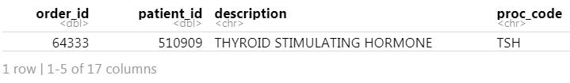
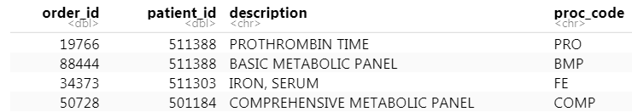
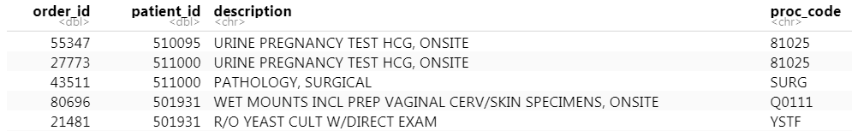
filter(orders, proc_code == "TSH", patient_id == "510909")
filter(orders, pref_list_type == "Clinic Preference List" |
pref_list_type == "Provider Preference List",
!is.na(reason_for_canc_c))
filter(orders, department %in% c("OB GYN CLINIC","GERIATRIC CLINIC","PEDIATRIC CLINICS"))

Slide 40
arrange()
Notes:
Often when exploring your data you’ll be interested in organizing the rows according to values in a specific column or columns. That’s what arrange() does. It let’s you focus on the most important parts of your data by rearranging and organizing it.

Slide 41
arrange()
Order rows from smallest to largest values
arrange(data,... )
data frame to transform
name(s) of columns to arrange by
Notes:
As we’ve seen, dplyr functions all have similar syntax and arrange is no exception. The data frame is your first argument. After that you can list one or more columns, each separated by a column, to arrange the data frame by.

Slide 42
arrange()
Order rows from smallest to largest values
arrange(orders, result_time)
order_id | patient_id | description | result_time
19766 | 511388 | PROTHROMBIN TIME | 2017-09-20
88444 | 511388 | BASIC METABOLIC PANEL | 2017-09-01
40477 | 508061 | THYROID STIMULATING HORMONE | 2017-09-28
97641 | 508061 | T4, FREE | 2017-09-04
order_id | patient_id | description | result_time
88444 | 511388 | BASIC METABOLIC PANEL | 2017-09-01
97641 | 508061 | T4, FREE | 2017-09-04
19766 | 511388 | PROTHROMBIN TIME | 2017-09-20
40477 | 508061 | THYROID STIMULATING HORMONE | 2017-09-28
Notes:
In this example we are arranging orders data frame by the result_time, which allows us to review the orders in the order in which the results were generated, rather than the seemingly haphazard way they have been exported in this data set.

Slide 43
arrange()
Order rows from smallest to largest values
arrange(orders, desc(result_time))
order_id | patient_id | description | result_time
19766 | 511388 | PROTHROMBIN TIME | 2017-09-20
88444 | 511388 | BASIC METABOLIC PANEL | 2017-09-01
40477 | 508061 | THYROID STIMULATING HORMONE | 2017-09-28
97641 | 508061 | T4, FREE | 2017-09-04
order_id | patient_id | description | result_time
40477 | 508061 | THYROID STIMULATING HORMONE | 2017-09-28
19766 | 511388 | PROTHROMBIN TIME | 2017-09-20
97641 | 508061 | T4, FREE | 2017-09-04
88444 | 511388 | BASIC METABOLIC PANEL | 2017-09-01
Notes:
Sometimes we’ll be interested in viewing the data in reverse chronological order. By default arrange will order the rows from smallest to largest, from a to z, or from earliest date to latest. We can reverse this by wrapping our column of interest in the desc() function.

Slide 44
arrange()
Order rows from smallest to largest values
arrange(orders, patient_id, result_time)
order_id | patient_id | description | result_time
19766 | 511388 | PROTHROMBIN TIME | 2017-09-20
88444 | 511388 | BASIC METABOLIC PANEL | 2017-09-01
40477 | 508061 | THYROID STIMULATING HORMONE | 2017-09-28
97641 | 508061 | T4, FREE | 2017-09-04
order_id | patient_id | description | result_time
97641 | 508061 | T4, FREE | 2017-09-04
40477 | 508061 | THYROID STIMULATING HORMONE | 2017-09-28
88444 | 511388 | BASIC METABOLIC PANEL | 2017-09-01
19766 | 511388 | PROTHROMBIN TIME | 2017-09-20
Notes:
Let’s say we want to arrange the orders by patient first, and then by date. When listing only one column, ties will be arranged on the basis of the order they appeared in the original data frame. However if two columns are listed then the second column will be used as a tie-breaker. Additional columns can be added to further order tied rows.

Slide 45
Exercise 5
Arrange orders by order_status_c_descr. What order statuses appear in the top rows of the data frame?
Add order_class_c_descr as a second (tie breaking) variable to arrange on, but order it in reverse alphabetical order. Explore what type of order class appears at the top of the data frame. To what type of lab test does this order class seem to relate to?
03:00

Slide 46
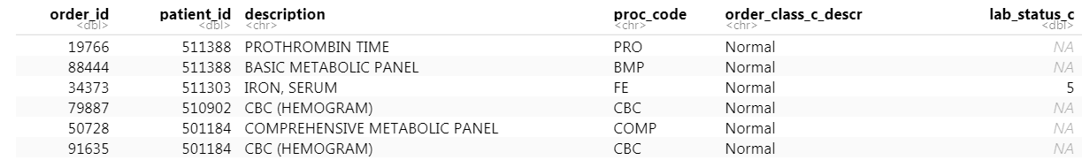
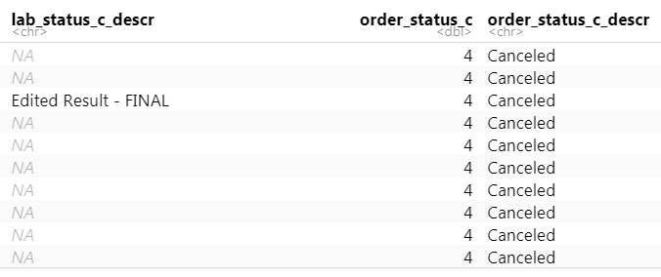
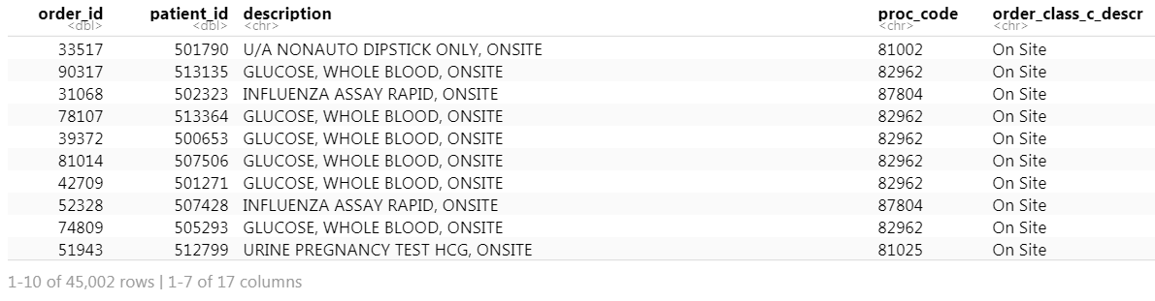
arrange(orders, order_status_c_descr)
arrange(orders, order_status_c_descr,
desc(order_class_c_descr))

Slide 47
%>%
Notes:
Now that we have a decent toolkit of functions with which to manipulate our data we should take a step back and talk about the data analysis process.
In any real data manipulation task you're probably not just going to use one verb but you're going to string multiple verbs together into a series of steps that overall accomplish a goal.

Slide 48
Data Analysis Steps
VITD <- filter(orders, description == "1,25 DIHYDROXY VITAMIN D")
VITD <- select(VITD, department, ordering_route, pref_list_type)
VITD <- arrange(VITD, department)
1. Filter orders to 1, 25 Vitamin D
2. Select the relevant columns that contain ordering information
3. Arrange those columns by department
Notes:
For instance, in the context of the orders data set, one may investigate the ordering of tests that are not recommended for routine use, such as 1,25 dihydroxy vitamin D. The 25-hydroxy vitamin D level is the preferred test for screening for vitamin D deficiency. The 1,25 dihydroxy vitamin D level is used in rare and unique clinical situations, however it is often ordered by unwitting providers. To determine who is ordering the non-recommended test, one could start by filtering to the relevant test, select the columns that were necessary, and then maybe arrange the rows in a useful way.
It’s easy to see that this analysis requires a lot of typing, and has a lot of redundancy in that we sequentially update the new data frame 125VITD as wel progress through the analysis.

Slide 49
Data Analysis Steps
125VITD <- arrange(
select(
filter(
orders,
description == "1,25 DIHYDROXY VITAMIN D"
),
department,
ordering_route,
pref_list_type
),
pref_list_type
)
Notes:
An alternative would be to nest these functions one within the other. When nesting functions the innermost function is evaluated first followed sequentially by the next inner ones. We can see that we have made the code much more efficient but at a significant price. The code is really complicated to look at, it’s not at all obvious what the code is trying to accomplish. The arguments for functions are spatially far away from the names of the functions themselves. For instance, the argument for arrange() is pref_list_type, but that’s not easy to see in this snippet of code. What would be helpful when performing fairly typical analyses such as these would be a syntax that was both efficient as well as human readable.

Slide 50
The Pipe Operator %>%
orders
filter(____, patient_id == 508061)
Passes result on left into first argument of function on right.
filter(orders, patient_id == 508061)
orders %>% filter(patient_id == 508061)
Notes:
This is exactly what the pipe operator does. The pipe operator does something very simple but at the same time incredible useful. It takes the product of whatever is on the left and puts it into the function on the right. So for instance, the two lines of code in the gray box do exactly the same thing. One advantage that you may notice is that the second snippet of code is immediately far more expressive in human language. You could read the statement as “Take the orders data frame, and then filter the patient_id column to rows containing 508061.”

Slide 51
Data Analysis Steps
125VITD <- arrange(
select(
filter(
orders,
description == "1,25 DIHYDROXY VITAMIN D"
),
department,
ordering_route,
pref_list_type
),
pref_list_type
)
Notes:
The advantage of this is even more clear when performing a more complicated analysis such as this one. You can take this code, which is essentially illegible, and transform it into the code on the following slide.

Slide 52
Data Analysis Steps
VITD <- orders %>%
filter(description == "1,25 DIHYDROXY VITAMIN D") %>%
select(department, ordering_route, pref_list_type) %>%
arrange(pref_list_type)
Notes:
The code here is far more succinct. It self describes what it does since it’s written in a sequential, essentially human readable format. This makes it easier to construct code as you’re performing analysis since this is how we think about an analytical pipeline. It also makes it much easier to understand when you’re coming back to it after having put it aside for several months. The pipe operator allows us to form chains of complicated data transformation operations that are made up of very simple, self-contained, building blocks. The goal is to make something complex by joining together many simple things that are easy to understand in isolation.

Slide 53
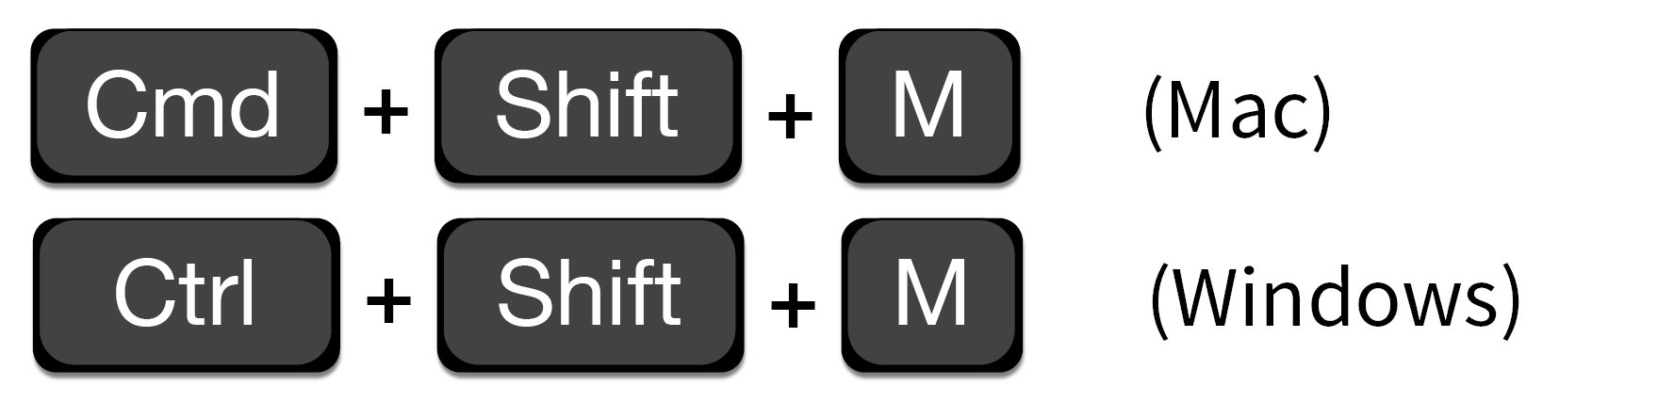
Shortcut to type %>%

Slide 54
Exercise 6
Use %>% to write a sequence of three functions that:
1. Filters to orders coming from the "BEHAVIORAL HEALTH CLINIC"
2. Selects the description, ordering_route, and pref_list_type
3. Arrange the dataset by the description and ordering_route columns
Using <-, assign the result to a new variable.
Use your mouse to select the name of the new data frame from the list of data sets in the upper-right pane of Rstudio. Do you notice any ordering patterns?
04:00

Slide 55
orders %>%
filter(department =='BEHAVIORAL HEALTH CLINIC') %>%
select(description,pref_list_type, ordering_route) %>%
arrange(description,ordering_route)

Slide 56
Isolating data
Extract variables with select()
Extract rows with filter()
Arrange rows, with arrange().

Slide 57
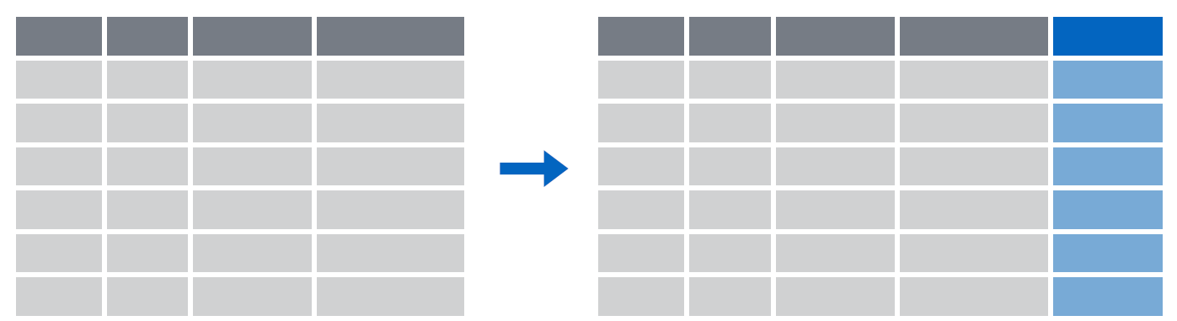
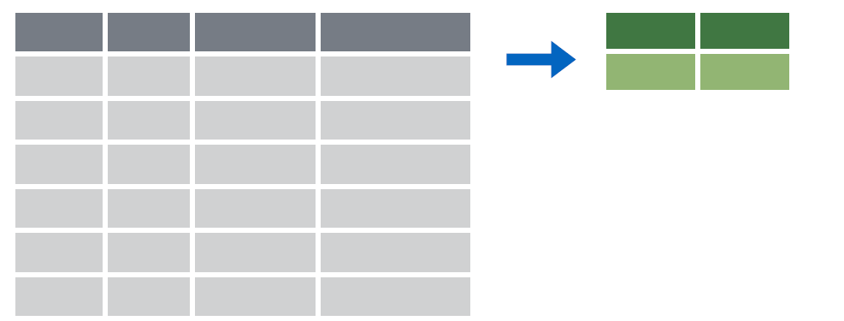
Deriving data
Make new variables with mutate()
Make summaries of data with summarize()

Slide 58
mutate()

Slide 59
mutate()
Creating new columns
orders %>%
mutate(new_column = calculation)
function whose results will populate columns
name for new column
equals

Slide 60
mutate()
Creating new columns
orders %>%
mutate(TAT = result_time – order_time)
order_id | result_time | order_time
19766 | 2017-09-20 11:59:00 | 2017-08-13 20:01:00
88444 | 2017-09-20 11:38:00 | 2017-08-13 20:01:00
40477 | 2017-09-01 11:50:00 | 2017-08-14 08:21:00
97641 | 2017-09-01 11:45:00 | 2017-08-14 08:21:00
order_id | result_time | order_time | TAT
19766 | 2017-09-20 11:59:00 | 2017-08-13 20:01:00 | 3254280 secs
88444 | 2017-09-20 11:38:00 | 2017-08-13 20:01:00 | 3253020 secs
40477 | 2017-09-01 11:50:00 | 2017-08-14 08:21:00 | 1567740 secs
97641 | 2017-09-01 11:45:00 | 2017-08-14 08:21:00 | 1567440 secs

Slide 61
Exercise 7
The weekdays() function will return the weekday for any date.
Use the weekdays() function to make a new column which contains the day of the week that each order was placed
Then select this column and the order_time
column
04:00

Slide 62
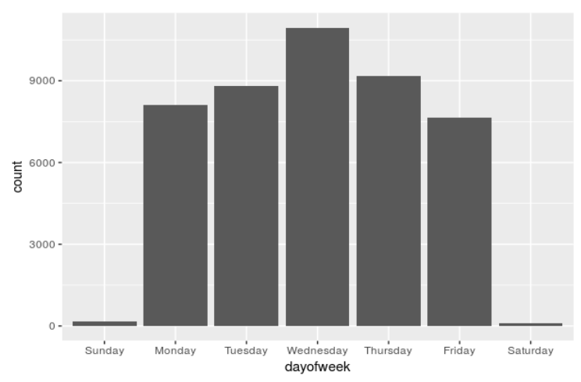
orders %>%
mutate(dayofweek = weekdays(order_time)) %>%
select(dayofweek, order_time)

Slide 63
mutate()
Replacing columns
orders %>%
mutate(pref_list_type =
pref_list_type %in% c("Clinic Preference List",
"Provider Preference List"))

Slide 64
mutate()
Conditionally replace values in a column
orders %>%
mutate(proc_code =
ifelse(proc_code %in% c("CBC","CBD"), "CBC",
proc_code))

Slide 65
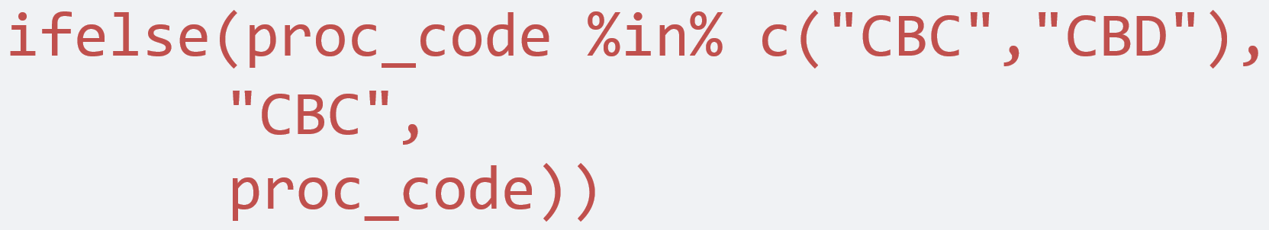
mutate()
Conditionally replace values in a column
orders %>%
mutate(proc_code =
ifelse(proc_code %in% c("CBC","CBD"), "CBC",
proc_code))
logical statement
value if true
value if false

Slide 66
select() helpers
Function | What it does | How it’s used
: | Select range of columns | select(orders, Order_ID:LAB_STATUS_C)
- | Select every column but | select(orders, -Patient_ID)
starts_with() | Select columns that start with | select(orders, starts_with("Order"))
contains() | Select columns that contain | select(orders, contains("Time"))
Notes:
alternative

